Slide 1
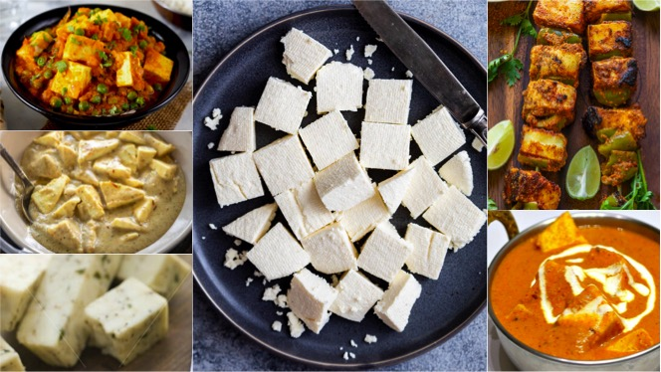
PROJECT ON ENTREPRENEURSHIP
DEVELOPMENT OF PANEER INDUSTRY
GUIDED BY – APURBA GIRI¹ &
AYAN MONDAL²
HEAD OF ASSISTANT PROFESSOR¹
ASSISTANT PROFESSOR²
(DEPT. OF NUTRITION)
Mugberia Gangadhar Mahavidyalaya
PROJECTED BY –TANUSHREE JANA
Roll – 2241
Department of Nutrition,
B.Voc Food Processing 6th semester
Mugberia Gangadhar Mahavidyalaya

Slide 2
.

Slide 3
WHY I STARTED THIS BUSINESS ?
High market demand and growing industry
High profitable business
It can be start in a small plan
Manufacturing procedure is very simple
Marketing is very simple because of high demand in populated areas

Slide 4
BUSINESS MANAGEMENT FUNCTION
Planning
Organizing
Coordinating
Directing
Controlling

Slide 5
LOCATION & AREA
Raw material availability.
Location ( with respect to the marketing area)
Availability of suitable land.
Transport facilities.
Availability of labours.
Availability of utilities ( Water, Electricity ).
Environmental impact and effluent disposal.
Local community considerations.
Climate
Political strategic consideration
Area :- 2000-2500 sq.ft

Slide 6
CERTIFICATE & LICENSE
Food Safety & Standards Authority of India (FSSAI) Food License
ESI or Employee State Insurance
GST
Trademark Registration
No Objection Certificate

Slide 7
INVESTMENT
Total Investment – 28-35 Lakhs
Land | ₹ 700000
Raw Materials( Milk, Citric Acid) | ₹ 300000
Machinery | ₹ 1450000
Van | ₹ 600000
Labors | ₹ 130000
Electricity | ₹ 50000
Others | ₹ 50000

Slide 8
Man Power 15 People
Receiving section | 2 Labours | 8000 x 2 =16000
Processing Section | 4 (1 Production manager, 3 labours) | 10000+(8000 x 3 =24000)=340000
Lab | 3 lab assistant | 12000 x 3= 36000
Packaging Section | 4 (2 cutting, 2 Packaging) | 8000 x 4 =32000
Store Room | 2 labours | 8000 x 2 =16000
Total =134000

Slide 9
Machinery Detalis
10 HP Motor - ₹ 50k
Paneer Making Vat 1000L ₹50000

Slide 10
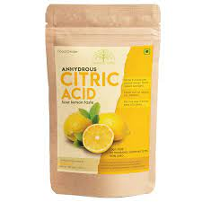
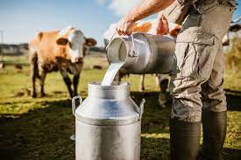
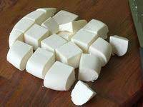
RAW MATERIALS
Water
Milk
Citric acid
TYPES OF PRODUCT
Low Fat Paneer
Paneer

Slide 11
MANUFACTURING PROCESS OF PANEER
QC check for Fat & SNF
Low Fat Paneer-3.5%,8.10%
Paneer- 4%,13.25%
Transfer milk from raw milk silo to double jacketed SS vat
Circulation through pre-heater to attain temperature of 82 to 85°C
Lowering temperature to 78°C
Addition of 2% citric acid solution [water-100L, Citric acid -3 kg,(Low Fat-5 kg)]
Coagulation
Compressed by placing it in SS dice with 6 PSI pressure for 12 minutes
Filtration of Coagulum
Transfer pressed block in chiled water at 5 to 7°C for 40 minutes
Transfer to brine solution of o.3% salt
Store in cold room at 5-7°C overnight
Coding on the pouch
Vaccum packing & Sealing
Weighing & cutting the Paneer block as per required
Generation of cut pieces then mashing of cut pieces &mixing in hot water & Reuse
Storing in chest freezer at 3-5°C

Slide 12
PRODUCT DETAILS
 | 250gm | 500gm | 1kg | 2kg
Milk (per L=40) | 80/- | 120/- | 280 | 500
Acid (per kg=400) | 8 | 10 | 15 | 18
water | 5 | 7 | 7 | 7
labour | 7 | 7 | 7 | 7
Packaging materials | 5 | 10 | 12 | 15
Electricity | 5 | 10 | 15 | 15
Total cost
110
164
336
562
 | WHOLESALERS | MRP | PROFIT
250gm | 120 | 130 | 20
500gm | 230 | 250 | 86
1kg | 380 | 390 | 54
2kg | 595 | 610 | 48

Slide 13
Plant Layout
In
Out

Slide 14
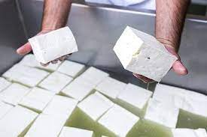
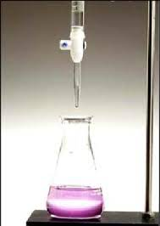
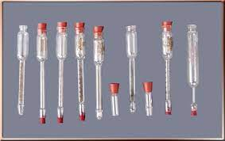
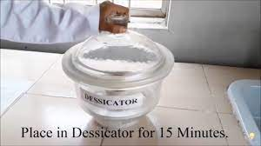
LABORATORY TEST
Physical :-
Sensory Test (Texture, colour, odor)
Chemical:-
Fat Test
Acidity Test
Moisture Test
Microbiological:-
(Bacterial spores, Coliform count, Yeast & Mould count )

Slide 15
MARKET STRATEGY
Firstly, Digital Marketing
Secondly, Advertising
Thirdly, Sales promotion
Fourth, Direct Marketing
DISTRIBUTION PROCESS
Raw material
Plant
Distributor
Retailer
customer

Slide 16
ADVERTISEMENT & PROMOTION

Slide 17
TARGETED CUSTOMERS
Wholesalers
Retailers
Restaurants
Hotels
Online
Others customer
Middle and upper class households
Marriage & Occasion

Slide 18
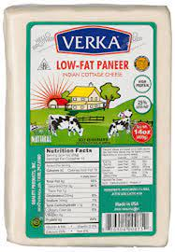
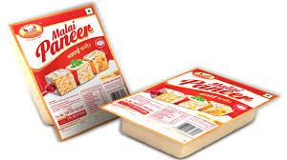
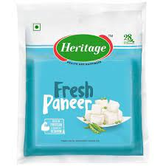
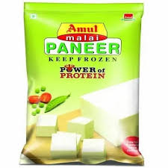
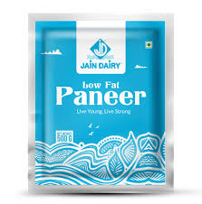
ANALYSIS OF COMPETITOR

